Slide 1

Project 2: Club Grub App
Milestone 2
Android App with Calendar View and Detail View that links to Firebase free food event information

Slide 2
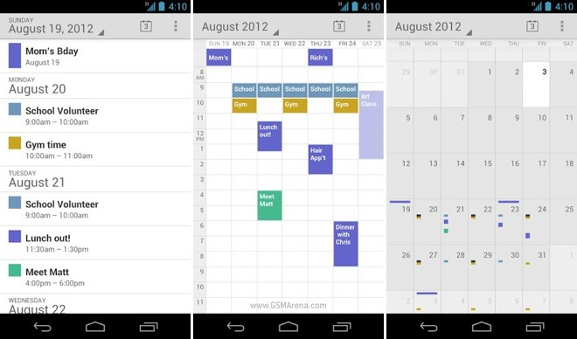
Calendar Activities – add to google calandar
Runners club breakfast
runners
club bfast
runners
club bfast
Physics
coffee
Physics
coffee
Physics
coffee
Physics
coffee
Physics
coffee
Church
open house
lunch
Physics coffee
Alumni
breakfast
Alumni
breakfast
Alumni
breakfast
Math
pizza
Alumni Breakfast
Math
pizza
Physics coffee
Drone club
pizza
Math pizza
Mobile
makers
pizza
Drone club pizza

Slide 3
Detail View
Math Pizza
Group: Math Club
Time/Date: Thursday 4/13 at 7pm
after clicking on a particular event,
you will be taken to this view to see
the information about that event in
a detail view activity
Location: Math B125
Full Email Text (image):
This is where the full body of the email which I scraped will available such that minor details can be conveyed.

Slide 4
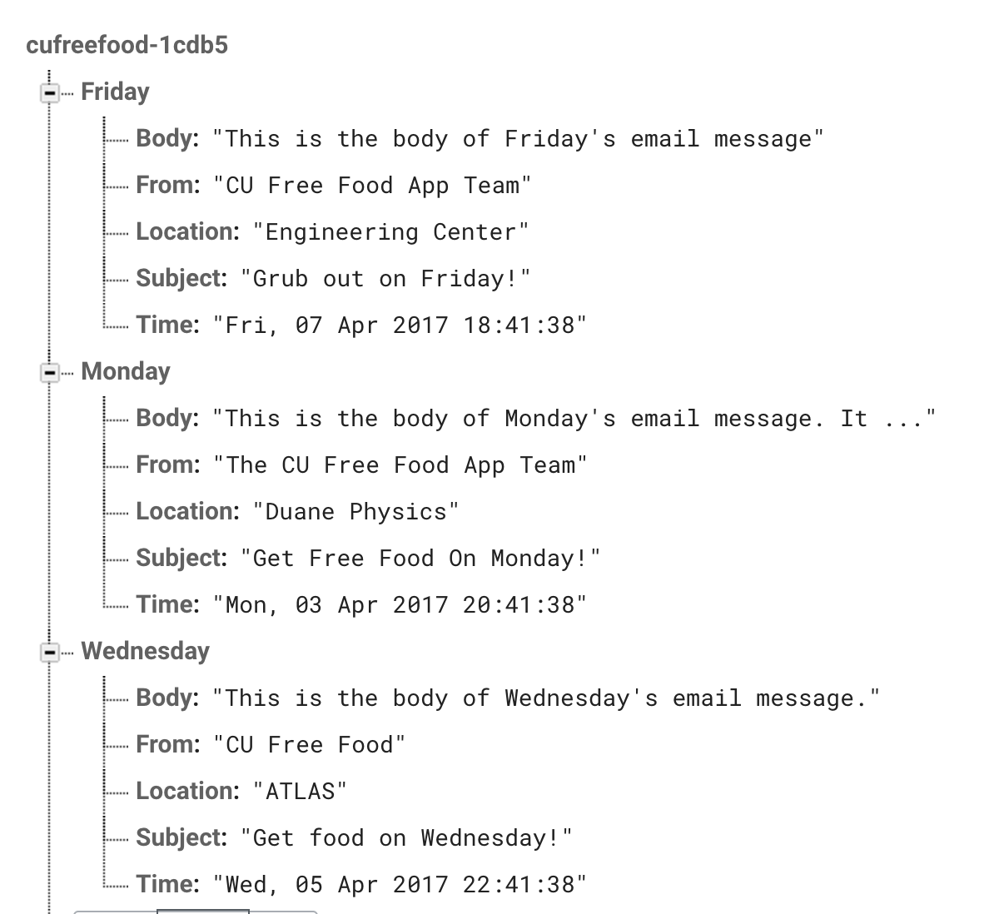
Firebase Data

